Slide 1
RNN, LSTM, Attention
Or how to deal with sequential data

Slide 2


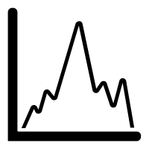
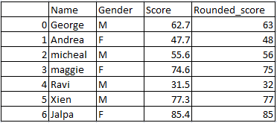
Sequential data ?
Non-sequential
Sequential

Slide 3
Non-sequential data can be seen as sequential data
Sequentially add colors to the image to generate a picture
Idea of sequential visual attention (which part is read first ?)
http://karpathy.github.io/2015/05/21/rnn-effectiveness/

Slide 4
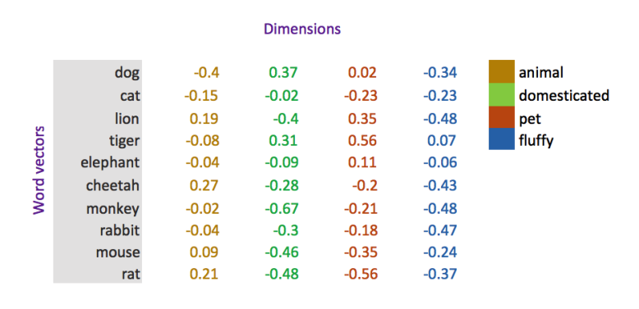
RNN, Recurrent Neural Network
X₁ = I
x₂ = love
X₃ = mashed
X₄ ₌ potatoes
I love mashed potatoes
X₁ = The
x₂ = neighbour
X₃ = has
X₄ = a
X₅ = nice
X₆ = cat
The neighbour has a nice cat
Associate to every word x_{i} a numerical vector called an embedding (or vector representation) to be able to process it.

Slide 5
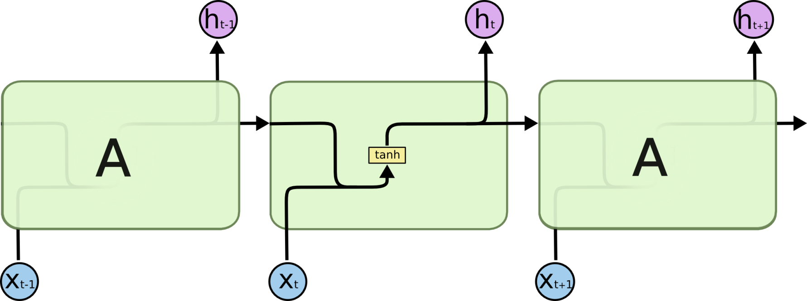
RNN
x_{t} = words of input sentence
h_{t} = hidden state

Slide 6
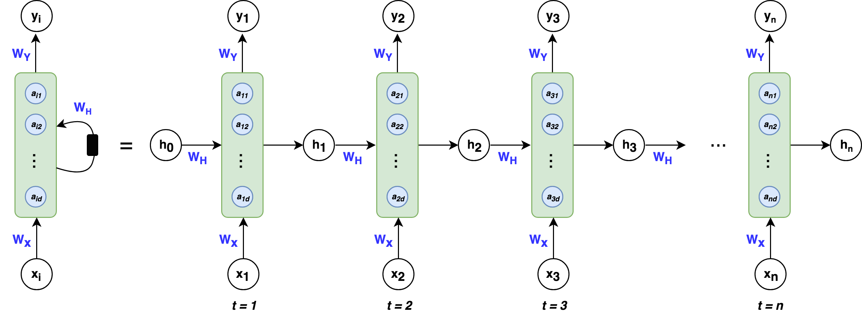
RNN
x_{i} = words of input sentence
h_{i} = hidden state
y_{i} = hidden sequence, words of input “encoded” by the network
W_{H}, W_{Y}, W_{X} = weight matrixes
a_{id} = hidden neurons, tanh activated

Slide 7
RNN is a good idea
Keep some idea of context
Can deal with sequential data of any length (it is always the same W,U,V matrices being updated )
Last hidden state h_{T} gives a representation of the whole sentence

Slide 8
RNN has issues
Vanishing gradient or exploding gradient
See TP ☺
Very short term memory (usually only what comes two to three word before)
only suited to some applications

Slide 9

LSTM, just an RNN with gates

Slide 10




Gates of LSTM
Forget gate
Input gate
Output gate
C_{t}

Slide 11
LSTM : pros and cons
Helps solving the vanishing gradient issue
Retains past events in the long-term
Gives a vector representation of the whole sentence
May lose memory of the beginning of the sentence if it is long
Does no take context into account (for prediction of a word, classification of discourse,…)
Pros
Cons

Slide 12
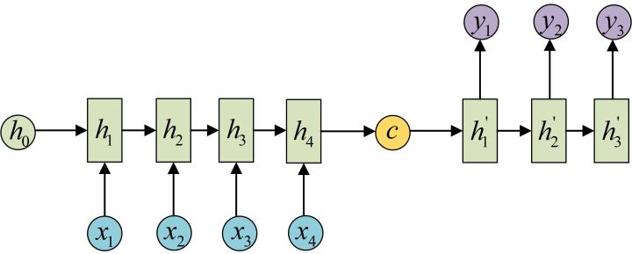
Sequence-to-sequence models
Historically : machine translation, auto captioning
2 LSTM one after the other
In the middle : the context vector
Encoding
Decoding

Slide 13
Seq2seq : issues
Bottleneck : context vector c
It is enough to keep the general idea of a sentence
But rather bad for fine-grained translations, or video captioning.

Slide 14
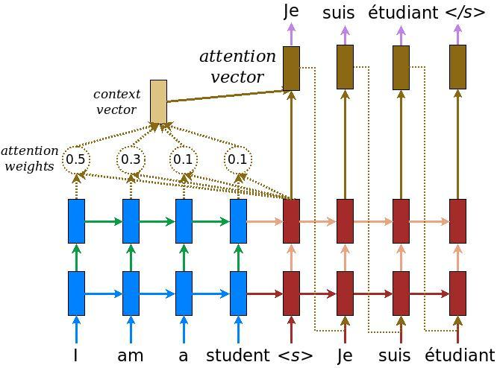
Attention !
Weight every prediction by not only the previous prediction, but by how well the previous prediction fit in the original sentence
Take into account the context of a word in relation to the whole sentence

Slide 15
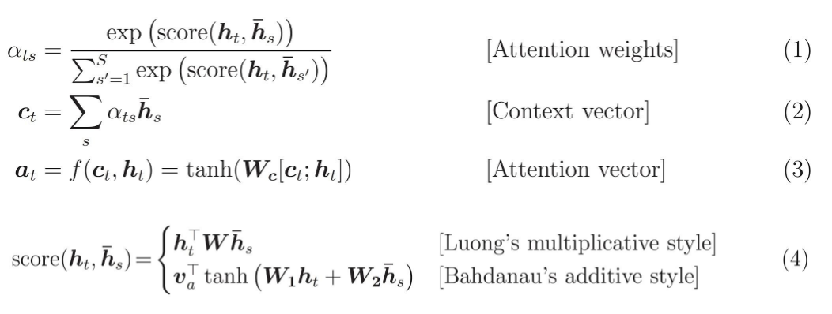
Attention !

Slide 16
Attention: do not fear
Complex mean-looking equations but the idea is simple : did you get it ?
Can be used :
Many-to-many (as in seq2seq)
Many-to-one (as we’ll do in TP)
Many-to-one : same attention, just one prediction to make, so less hassle about training and more focus on the mechanism.

Slide 17
Bonus : what is embedding and why do we use it ?
Encode words in a numerical format
One-hot-encoding
Embedding
OHE is a vector of the size of the vocabulary, with 1 if it is that word and 0 otherwise
Knowing which word of the vocab is used based on its “index”, almost

Slide 18
OHE : specificities
When the size of the vocabulary goes up (10 000, 50 000 words), what happens ?
No putting the word in its context
I | 1 | 0 | 0 | 0 | 0 | 0 | 0
like | 0 | 1 | 0 | 0 | 0 | 0 | 0
mashed | 0 | 0 | 1 | 0 | 0 | 0 | 0
potatoes | 0 | 0 | 0 | 1 | 0 | 0 | 0
You | 0 | 0 | 0 | 0 | 1 | 0 | 0
like | 0 | 1 | 0 | 0 | 0 | 0 | 0
your | 0 | 0 | 0 | 0 | 0 | 1 | 0
dog | 0 | 0 | 0 | 0 | 0 | 0 | 1

Slide 19
Embedding layer
Distributional hyposthesis : you know a word by the company it keeps
Simply put :
Take a OHE vector
Run it through a matrix
Obtain representations of the OHE of another dimension
The weights are trainable, and optimize the best/most discriminative vector representation of a word

